Slide 1
COMPRESSIVE STRENGTH OF CONCRETE
Presented By:
1.R. KOWSHALYA - SOLMALAI COLLEGE ENGINEERING - CIVIL

Slide 2
OUTLINE
Importance
Testing Procedure
Factors Affecting Compressive Strength
Grades of Concrete
Application
Conclusion
References

Slide 3
IMPORTANCE
Structural Integrity:
Compressive strength is a primary indicator of a concrete structure's ability to support loads without collapsing or deforming. It ensures the structural integrity and stability of buildings, bridges, dams, pavements, and other infrastructure.
Safety:
Determining the compressive strength of concrete ensures that structures can withstand anticipated loads safely throughout their design life.
Durability:
High compressive strength is often associated with increased durability of concrete structures, as it indicates resistance to various external factors such as weathering, chemical attacks, and abrasion.
Economic Considerations:
Understanding the compressive strength allows engineers to optimize the design of concrete structures, leading to cost-effective solutions.

Slide 4
TESTING PROCEDURE
Sampling:
Representative samples of freshly mixed concrete are collected from the batch
being delivered or placed.
Mold Preparation:
Cylindrical molds made of steel or plastic are used to cast concrete specimens
for compressive strength testing.
Casting Specimens:
The fresh concrete is carefully placed into the molds in layers, with each layer
compacted using a standard tamping rod or vibrator to remove air voids and
ensure uniform density.
Finishing:
Excess concrete is struck off the top of the molds using a straight edge, and the
surface is finished smoothly with a trowel.

Slide 5
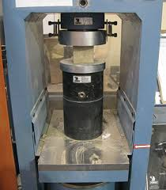
Curing:
After casting, the specimens are covered with plastic
sheeting or kept in a moist environment to prevent
moisture loss and ensure proper curing.
Demolding:
After the specified curing period, the molds are
carefully removed, and the concrete specimens are
labeled with identification information, including
the date of casting and specimen identifier.
Testing:
The specimens are placed in the testing machine, and a compressive load is
gradually applied until failure occurs. The maximum load at failure is recorded,
and the compressive strength is calculated by dividing this load by the cross
sectional area of the specimen.

Slide 6
FACTORS AFFECTING COMPRESSIVE STRENGTH
Water-Cement Ratio (w/c):
The water-cement ratio significantly affects concrete's strength. Lower
water-cement ratios typically result in higher compressive strengths. Excess Water
leads to increased porosity and weakens the concrete.
Water-Cement Ratio (w/c):
The water-cement ratio significantly affects concrete's strength. Lower water
cement ratios typically result in higher compressive strengths. Excess water Leads
to increased porosity and weakens the concrete.
Aggregate Properties:
Aggregate type, size, shape, and grading influence concrete strength.
Admixtures:
Admixtures such as water reducers, superplasticizers, and accelerators can
improve workability, reduce water content, and enhance strength under certain
conditions.

Slide 7
Mix Proportions:
The proportions of cement, aggregates, water, and admixtures in the
concrete mix influence its strength. Optimal mix proportions are determined
based on factors such as desired strength, workability, and durability
requirements.
Construction Practices:
Factors such as proper consolidation, adequate compaction, and correct
placement techniques can affect concrete strength.
Environmental Conditions:
Environmental factors such as temperature, humidity, and exposure to
chemicals or aggressive substances can impact concrete strength.

Slide 8
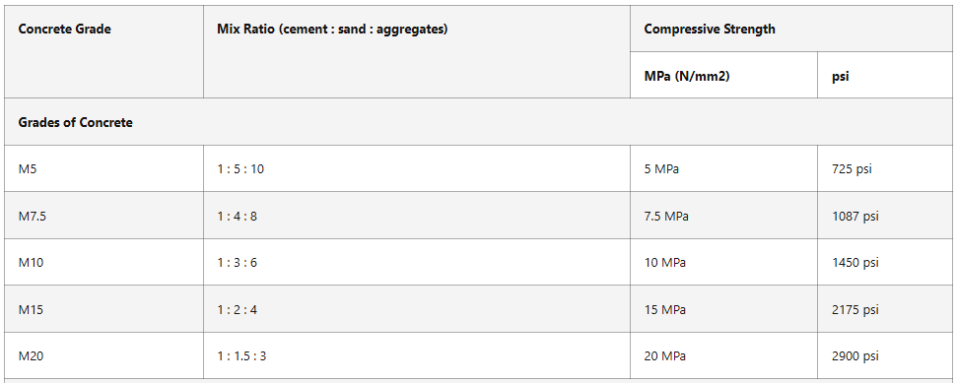

GRADES OF CONCRETE

Slide 9
APPLICATION
Building Construction:
Compressive strength is crucial in the construction of residential,
commercial, and industrial buildings. It ensures that concrete components such
as columns, beams, slabs, and walls can withstand the loads imposed by the
structure's weight and occupants.
Bridges and Infrastructure:
Compressive strength is essential for the construction of bridge components
such as abutments, piers, and decks. High-strength concrete is often used in
bridge construction to support heavy traffic loads and ensure structural integrity.
Dams and Hydraulic Structures:
Dams and other hydraulic structures require concrete with high compressive
strength to withstand the pressure exerted by water. Compressive strength is critical
in ensuring the stability and safety of these structures.
It is a critical parameter that influences the design, construction, and performance
Of a wide range of structures and infrastructure projects across various industries.

Slide 10
COCLUSION
To conclude, all parameters remaining identical, concrete compression strength will be higher for concrete made using fine aggregates having lesser finer fines, aggregates having maximum aggregate size, aggregates having rounded shape and/or aggregates having less porosity/ having density.

Slide 11
FUTURE SCOPE
The future holds several promising avenues for advancing the
Compressive strength of concrete and improving its performance in
various applications. Here are some potential areas of future development:
Innovative Materials
Nano-engineered Concrete
Fiber-Reinforced Concrete (FRC)
High-Performance Concrete (HPC)
Additive Manufacturing (3D Printing)
Smart Concrete Technology
Carbon Capture and Utilization (CCU)
Bio-based Concrete

Slide 12
REFERENCE
https://www.kaggle.com/datasets/gauravduttakiit/compressive-strength
of-concrete

Slide 13
THANKYOU

